Slide 1
Discrete Mathematics
South China University of Technology
1

Slide 2
Chapter 7. Relations
n-ary Relations and Their Applications
Section 7.2
2

Slide 3
Contents
1
N-ary Relations and Databases
2
Operations on N-ary Relations
3
SQL
3

Slide 4
N-ary Relations and Databases
4

Slide 5
§7.2: n-ary Relations
An n-ary relation R on sets A₁,…,A_{n}, is a subset R ⊆ A₁× … × A_{n}.
This is a straightforward generalisation of a binary relation. For example:
3-ary relations:
a is between b and c;
a gave b to c

Slide 6
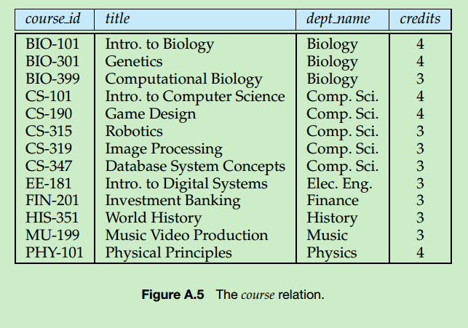
§7.2: n-ary Relations
An n-ary relation R on sets A₁,…,A_{n}, is a subset R ⊆ A₁× … × A_{n}.
The sets A_{i} are called the domains of R.
The degree of R is n.

Slide 7
§7.2: n-ary Relations
R is functional in the domain A_{i} if it contains at most one n-tuple (…, a_{i} ,…) for any value a_{i} within domain A_{i}.
Generalisation: being functional in a combination of two or more domains.

Slide 8
Relational Databases
A relational database is essentially just a set of relations.
A domain A_{i} is a primary key for the database if the relation R is functional in A_{i}.
A composite key for the database is a set of domains {A_{i}, A_{j}, …} such that R contains at most 1 n-tuple (…,a_{i},…,a_{j},…) for each composite value
(a_{i}, a_{j},…)∈A_{i}×A_{j}×…
Notes:
This notation is a bit sloppy in that it suggests incorrectly that a composite key can consist of an infinite set of domains.
(This is to make things more readable.)

Slide 9
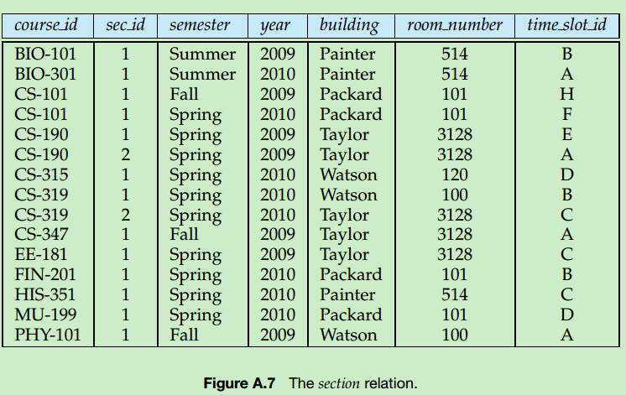

Slide 10
Example of Relational Data Model
(Student Name, ID Number, Major, GPA)
(Ackermann, 231455, Computer Science, 3.88)
(Adams, 888323, Physics, 3.45)
(Chou, 102147, Computer Science, 3.49)
(Rao, 678543, Mathematics, 3.90)
(Stevens, 786576, Psychology, 2.99)
Primary key is ID Number.

Slide 11
Operations on N-ary Relations
11

Slide 12
(Selection Operators)
Let A be any n-ary domain A=A₁×…×A_{n}, and let C:A→{T,F} be any predicate (condition) on elements (n-tuples) of A.
Then, the selection operator s_{C} is the operator that
s_{C}(R) = {a∈R | C(a) = T}

Slide 13
(Selection Operator Example)
Suppose we have a domain A = StudentName × Standing × SocSecNos
Suppose we define a condition Upperlevel on A: UpperLevel(name,standing,ssn) :≡ [(standing = junior) ∨ (standing = senior)]
Then, s_{UpperLevel} is the selection operator that takes any relation R on A (database of students) and produces a relation consisting of just the upper-level students (juniors and seniors).

Slide 14
(Projection Operators)
Then the projection operator on n-tuples is defined by:

Slide 15
(Projection Example)
Suppose we have a ternary (3-ary) domain Cars=Model×Year×Color. (note n=3).
Consider the index sequence {1,3}. (m=2)
Then the projection P maps each tuple (a₁,a₂,a₃) = (model,year,color) to its image:
This operator can be usefully applied to a whole relation R⊆Cars (a database of cars) to obtain a list of the model/color combinations available.
{1,3}

Slide 16
(Join Operator)
Puts two relations together to form a combined relation which is their composition:
Iff the tuple (A,B) appears in R₁, and the tuple (B,C) appears in R₂, then the tuple (A,B,C) appears in the join J(R₁,R₂).
A, B, and C can also be sequences of elements.

Slide 17
(Join Example)
Suppose R₁ is a teaching assignment table, relating Lecturers to Courses.
Suppose R₂ is a room assignment table relating Courses to Rooms,Times.
Then J(R₁,R₂) is like your class schedule, listing (lecturer,course,room,time).
(For precise definition, see Rosen, p.486)

Slide 18
SQL
18

Slide 19
Example of SQL
SELECT Departure_time FROM Flights
WHERE destination = ‘Detroit’
SELECT professor, time FROM teaching_assignments, class_schedule WHERE department = ‘mathematics’

Slide 20
End of Section 7.2
Click to edit company slogan .
20

